Slide 1
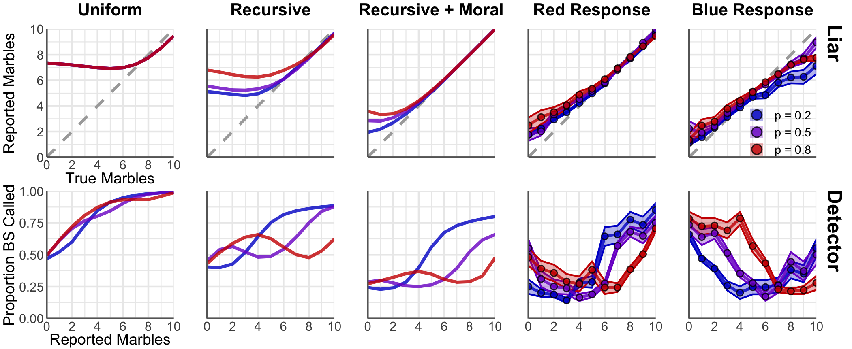

Slide 2
Uniform
Recursive
Recursive + Aversion
Red Response
Blue Response

Slide 3
Uniform
Recursive
Recursive + Aversion

Slide 4
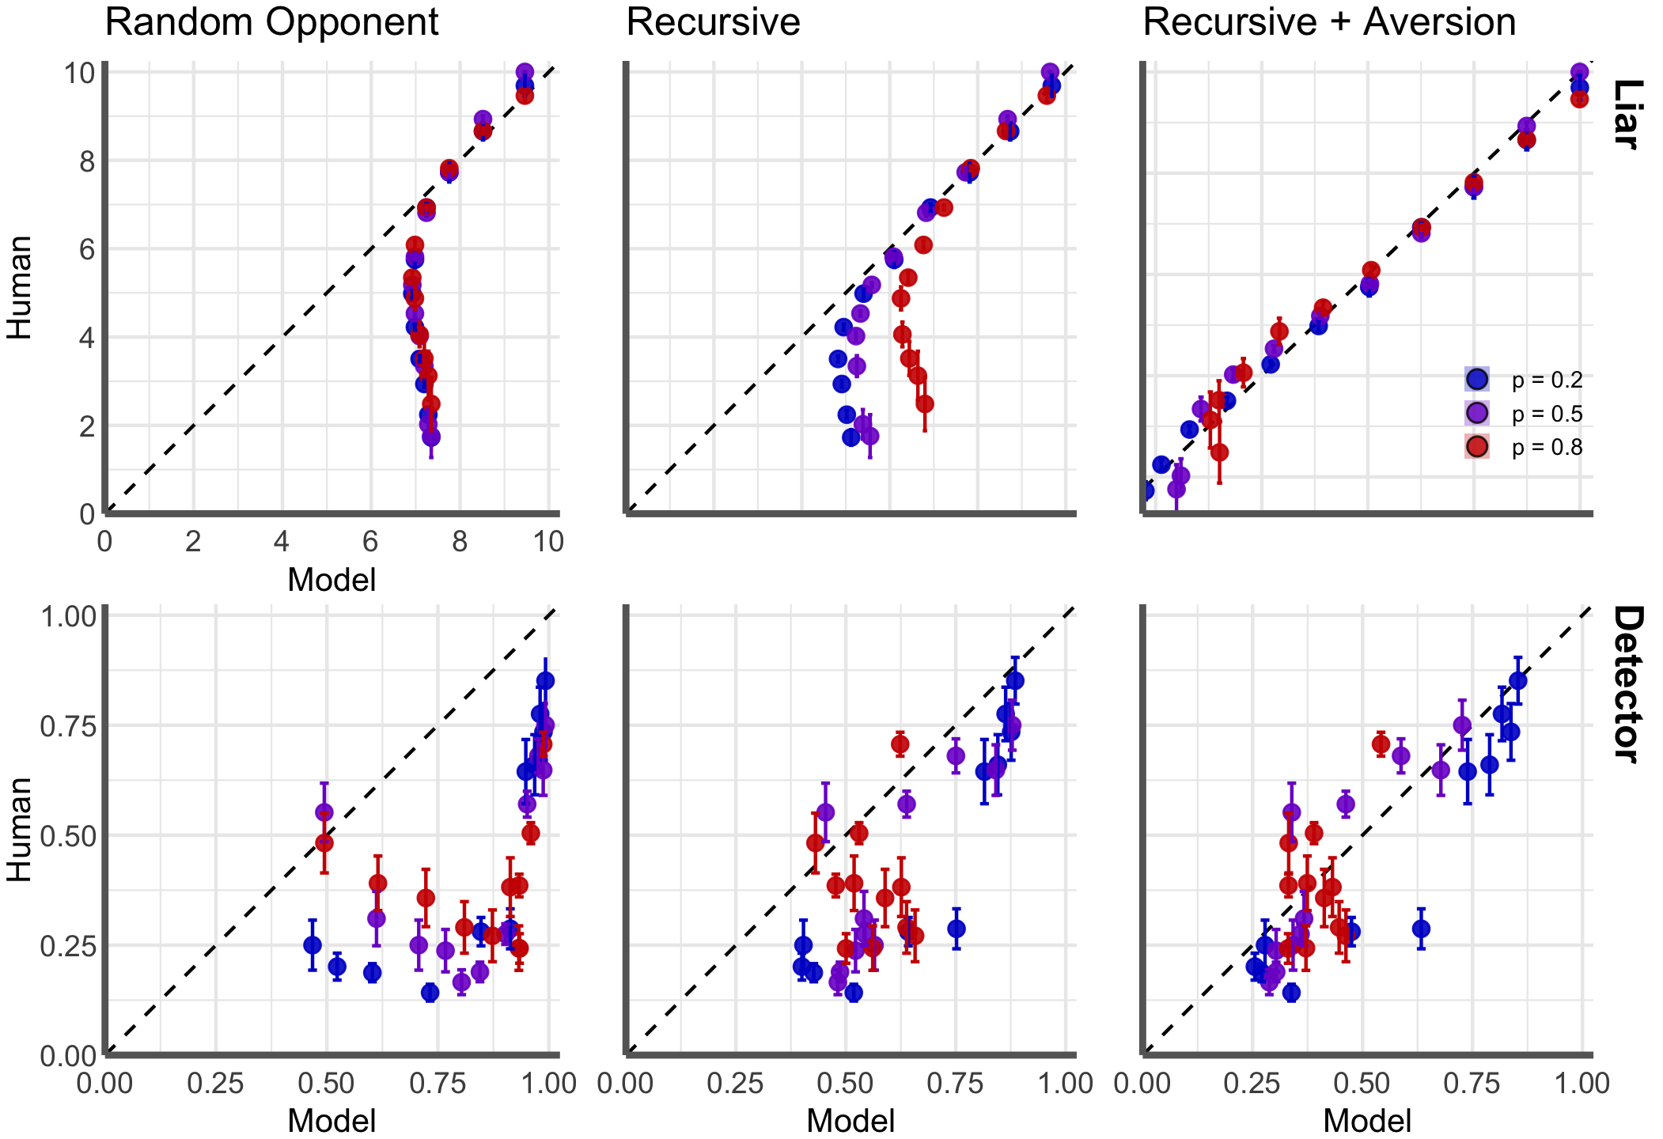
R² = 0.118
R² = 0.477
R² = 0.965
R² = 0.237
R² = 0.596
R² = 0.730

Slide 5
Human Response
Red Utility
Blue Utility

Slide 6









“dating
height”
P_{D}(BS | “dating height”)?
P_{L}(lie | “dating height”)?
P_{D}(BS | “dating height”)?

